Slide 1

MORE ABOUT BUGS
By Kristina Urbonienė
2022-03-30

Slide 2

BUG definition

Slide 3
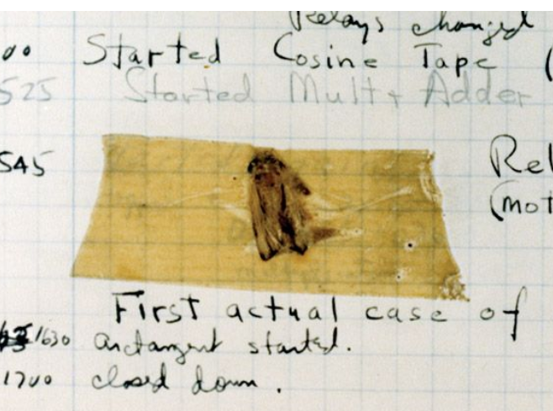
Short history of BUG definition
After finding a moth inside the Harvard Mark II computer on September 9th, 1947 at 3:45 p.m., Grace Murray Hopper logged the first computer bug in her log book. She wrote the time and the sentence: “First actual case of bug being found”.

Slide 4
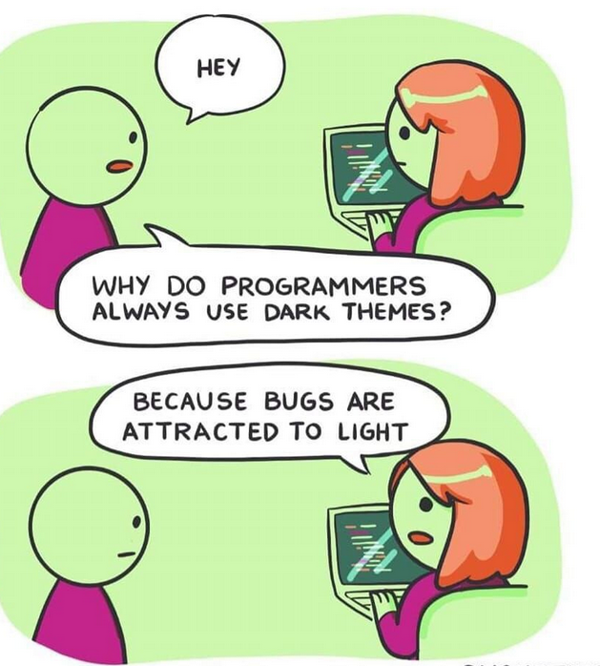
Why do bugs arise?
Unclear/incorrect requirements
Complex design
Poor skilled developer/tester
Complicated logic
Insufficient time/ lack of time
Less knowledge about product
Changing requirements often
Environment and/ or system issues
Human error

Slide 5
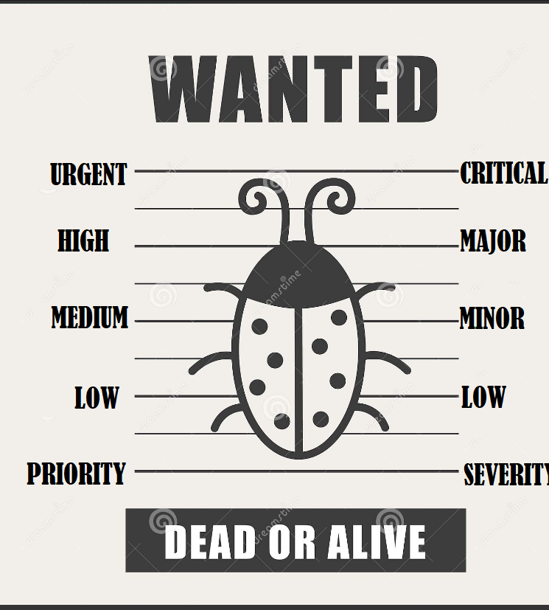
Classification: Priority and Severity

Slide 6
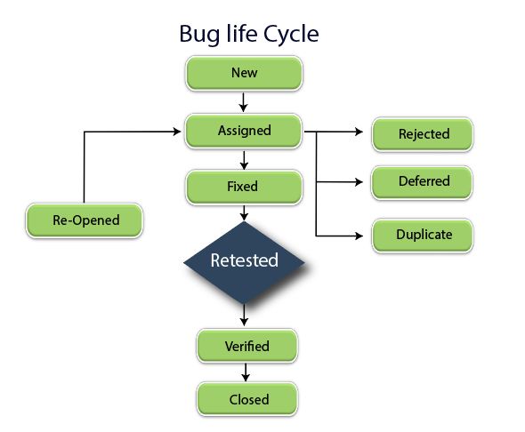
The bug life cycle is also known as the Defect life cycle.

Slide 7
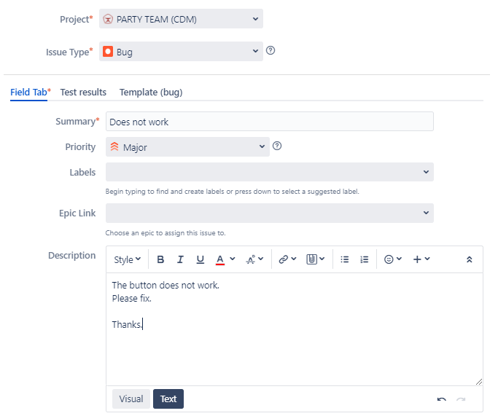
REGISTERING BUG (1st example)

Slide 8
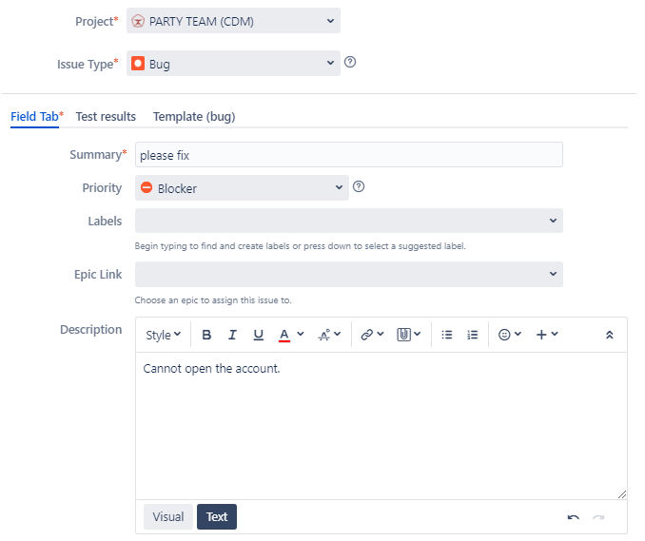
REGISTERING BUG (2nd example)

Slide 9
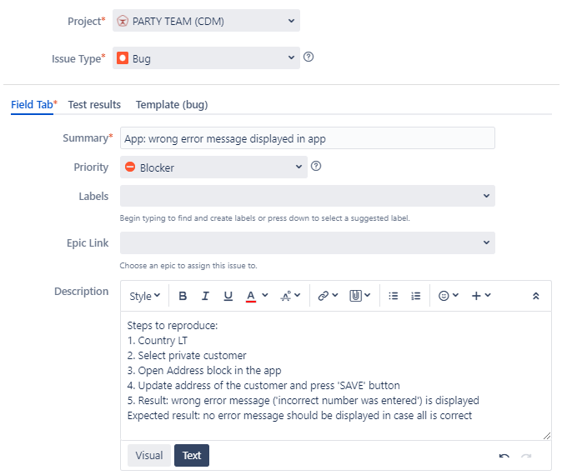
REGISTERING BUG (3rd example)

Slide 10
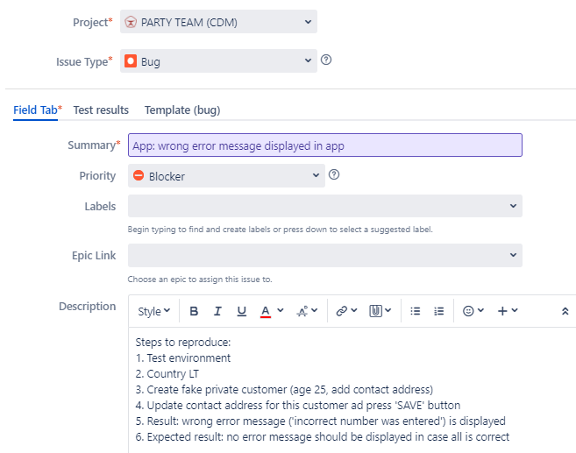
REGISTERING BUG (4th example).

Slide 11
When testing is enough? – Exit criteria
100% Requirements coverage is achieved
All High Priority defects are identified and fixed.
All critical Test cases are passed.
All major functional / business flows are executed successfully with various inputs and are working fine.
Test Finish deadline is reached.
Regression testing is complete.

Slide 12
After sprint/before release
Acceptance testing
01
Regression testing
02
Testing reports
03

Slide 13
Testing trends: Task
Team nr. 1 - Accessibility testing
Team nr. 2 - Exploratory testing
Team nr. 3 - IoT testing
Team nr. 4 - RPA (Robotic Process Automation) testing
Team nr. 5 - Big data testing
Team nr. 6 - API Testing
Time to prepare: 45 minutes.
Time to talk: 5 minutes.

